Slide 1

COMP 5350 / 6350 / 6356 Digital Forensics Spring 2019

Slide 2
Introduction to File Systems

Slide 3
File System Abstraction
DISK
PARTITION
FILE SYSTEM
DATA UNIT
METADATA
FILE NAME

Slide 4
What is a File System?
A file system provides the data structures necessary to store and retrieve data
Data in a file system is configured into different hierarchal structures that array files and directories
The layers composing a file systems include additional data categories:
Data Unit
Containers that hold file contents
Cluster / Block
Metadata
Data that describes a file
References to file storage location
File Size
MAC times
Filename
Data that assigns
DISK
PARTITION
FILE SYSTEM
DATA UNIT
METADATA
FILE NAME

Slide 5
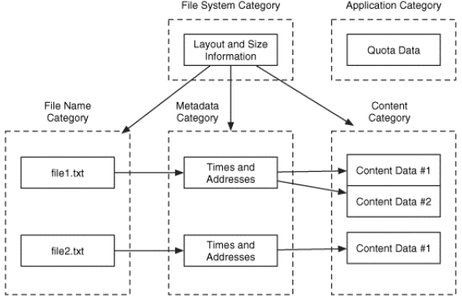
File System Data Categories
DISK
PARTITION
FILE SYSTEM
DATA UNIT
METADATA
FILE NAME

Slide 6
File Access
When a disk partition is created, the file system establishes how the data is structured along with metadata
File systems usually work on blocks or clusters
1 sector – 512 bytes
Block size - 1 to 128 sectors, depending on file system
Regardless of the data stored on storage media data is tracked based on its offset from the start of the partition and has reference addresses
Partitions and associated files are usually stored with a starting sector along with how many sectors are required to
The file system helps to specify:
Which sectors are occupied
Which sectors are free
Where is the file size stored
Where is the file name stored

Slide 7
Essential File System Data
Essential file system data are those needed to save and retrieve files
Reference addresses for accessing data
Filenames
Pointers to metadata
Additional, but non-essential file system data, include:
File access times
File permissions
The delineation between essential and non-essential data is based on trust
Essential data must be true, or data will not be accessible
When conducting a forensic analysis on data taken from media we must know both
The file system format used to store the data
The operating system that wrote the data to the file system

Slide 8
File Allocation Table (FAT16) File System Analysis

Slide 9
Operating System vs. File System
The following operating systems are closely associated with the following file systems:
Operating System | File Systems
MS-DOS | FAT16
Windows 95 | FAT16
Windows 98 | FAT32, NTFS
Windows NT | NTFS
Windows 2000 | NTFS
Windows XP | FAT32, NTFS
Windows 7 / 8 / 10 | NTFS
MacOS | HFS+
Linux – Debian | ext2
Linux – Red Hat 5 / 6 / 7+ | ext3 / ext4 / XFS
Linux – Ubuntu < 4.10 / > 9.1 | ext3

Slide 10
File System Attributes
There are numerous well established file systems:
File System | File Size | Partition Size | File Permissions
FAT12 | 16 MiB | 16 MiB
FAT16 | 2 GiB | 2 GiB
FAT32 | 4 GiB | 8 TiB
NTFS | 2 TiB | 256 TiB | X
ext2 | 2 TiB | 32 TiB | X
ext3 | 2 TiB | 32 TiB | X
ext4 | 16 TiB | 1 EiB | X
HFS+ | 2 GiB | 2 TiB | X
XFS | 8 EiB | 8 EiB | X

Slide 11
FAT File System
The File Allocation Table file system is a basic file systems
FAT is the principal file system used by legacy Windows operating systems
Microsoft DOS
Windows 9X
FAT file systems track data based on their location in a block / cluster
FAT is supported by all Windows and most Unix-based operating systems along with numerous compact flash cards and USB drives
File System | Max File Size | Max Partition Size | File Permissions
FAT12 | 16 MiB | 16 MiB | No
FAT16 | 2 GiB | 2 GiB | No
FAT32 | 4 GiB | 8 TiB | No

Slide 12
File Allocation Table Versions
FAT12
12-bit FAT entries
Cluster sizes from 512 bytes to 4 KB
Partitions smaller than 16MB
Legacy file system for small disks
FAT16
16-bit FAT entries
Cluster sizes from 2 KB to 32 KB
Partitions from 16MB – 2GB
Regardless of file size, all cluster space is taken
FAT32
28-bit FAT entries
Cluster sizes from 4 KB to 32 KB
Partitions from 512 MB – 2 TB
FAT32 permits file fragmentation

Slide 13
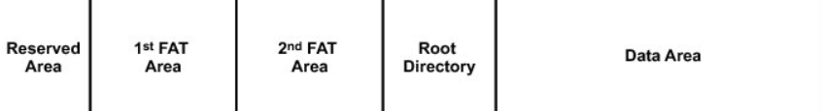
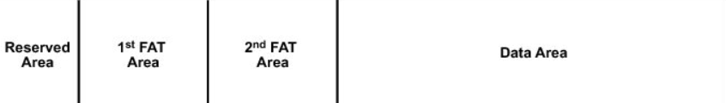
Organization of a FAT Partition
The simplicity of FAT is based on the small number of data structures used
Reserved Area
FAT Area(s)
Root Directory
Data Area
FAT16
FAT32

Slide 14
Organization of a FAT Partition
Reserved area – Boot sector code
Number of FATs
Sector sizes
Number of sectors in a cluster
File allocation table area
Table with one entry for each cluster in the partition
Multiple FATs are generated for redundancy
Root directory area
Fixed location for FAT 12 and FAT 16 partitions
FAT32 has a root directory, but is stored in the data area
Data area
Contains “Directory Entry Structure” which provide locations for files and directories
FAT supports only four attributes for files and directories
Read-Only
Hidden
System
Archive

Slide 15
FAT16 Partition
16-bit entries
1 entry for each cluster
Free Cluster (0x0000)
Occupied Cluster
0x0002 - 0xFFEF
Reserved Cluster (0xFFF6)
Bad Cluster (0xFFF7)
Last Cluster (0xFFF8-0xFFFF)
End of Cluster (0xFFFF)
Contains “Directory Entry Structure”
Provides addresses for files and directories
Boot sector code
# FATs
Sector Size
Sectors / Cluster
Redundant FAT
Contains address for root directory

Slide 16
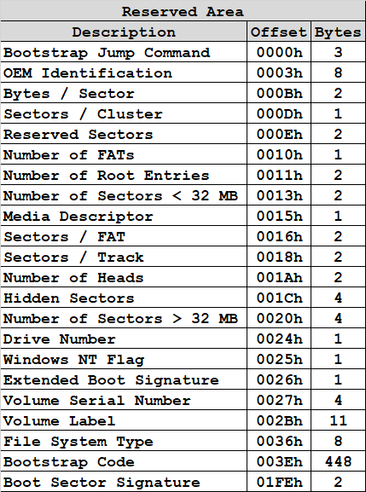
FAT16 Reserved Area Structure
1 sector
? sectors
? sectors
? sectors
? sectors
The FAT16 specification specifies a reserve are of 512 bytes
It takes 1 sector to specify FAT16 disk parameters and boot code
The Reserved Area has four groups
BIOS
Extended BIOS
From the contents of the reserved area, we will be able to find
FAT lengths
Root Directory Length
Data Area Length

Slide 17
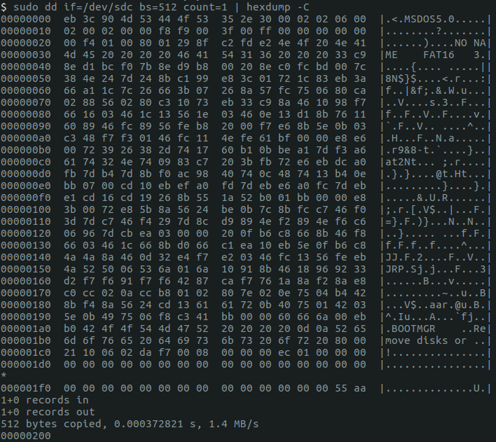
Reserved Area Hexdump
sudo dd if=/dev/sdc bs=512 count=1 | hexdump -C

Slide 18
Hexadecimal Representation
When displaying the address contents of media or networking protocols, the hexadecimal representation is more efficient than binary or decimal
Every position represents 1 byte (8-bits)
Based on the file system specification, groups of bytes will aggregated for specific definitions

Slide 19
Little Endian
Endian has to do with the byte order of data
Big Endian – Most Significant Byte First
Little Endian – Least Significant Byte First
Generally speaking, numeric values shown in a disk dump are “little endian”, whereas non-numeric values are “big endian”
Numeric Values
Non-Numeric Values
0x2C
0x2C
0x2C
0x2C
0x7465
0x8C014A6B
0x7465
0x8C014A6B
0x6574
0x6B4A018C
0x7465
0x8C014A6B

Slide 20
Boot Sector
Bootstrap Jump Command
B
0xEB3C90: Jump Short 3C NOP

Slide 21
Boot Sector
OEM ID
B
0x4D53444F53352E30: MSDOS5.0

Slide 22
Boot Sector
Bytes / Sector
L
0x0200: 512 bytes / sector

Slide 23
Boot Sector
Sectors / Cluster
L
0x02: 2 Sectors / Cluster

Slide 24
Boot Sector
Number of Reserved Sectors
L
0x0006: 6 Reserved Sectors – 3 KB

Slide 25
Boot Sector
Number of File Allocation Tables
L
0x02: 2 File Allocation Tables

Slide 26
Boot Sector
Number of Directory Entries
L
0x0200: 512 Directory Entries

Slide 27
Boot Sector
Small Sectors Count
L
0x0000: > 65535 Sectors in the Volume

Slide 28
Boot Sector
Media Descriptor Type
L
0xF8: Fixed disk – Hard Disk Partition

Slide 29
Boot Sector
Sectors / FAT
L
0x00F9: 249 Sectors / FAT – 127,488 bytes

Slide 30
Boot Sector
Sectors / Track
L
0x003F: 63 Sectors / Track

Slide 31
Boot Sector
Number of Storage Media Heads
L
0x00FF: 255 Storage Media Heads

Slide 32
Boot Sector
Number of Hidden Sectors
L
0x0000: 0 Hidden Sectors

Slide 33
Boot Sector
Large Sector Count
L
0x0001F400: 128000 Sectors – 65.5 MB

Slide 34
Boot Sector
Drive Number
B
0x80: 128

Slide 35
Boot Sector
Windows NT Flags
B
0x01: 1 Flag

Slide 36
Boot Sector
Signature
B
0x29: 29 – Next 3 fields are available

Slide 37
Boot Sector
Volume Serial Number
B
0x8FC2FDE2: 8FC2-FDE2

Slide 38
Boot Sector
Volume Serial Number Derivation
Month & Day
0x8FC2
Second & msec
8FC2-FDE2
Hour & Minute
0xFDE2
Year

Slide 39
Boot Sector
Volume Label String
B
0x4E4F204E414D45202020: “No Name “

Slide 40
Boot Sector
System Identifier String
B
0x4641543136202020: “FAT16 “

Slide 41
Boot Sector
Boot Code
B

Slide 42
Boot Sector
Bootable Partition Signature
B
0x55AA: Bootable Partition Signature

Slide 43
FAT16 Analysis
Practical Exercise

Slide 44
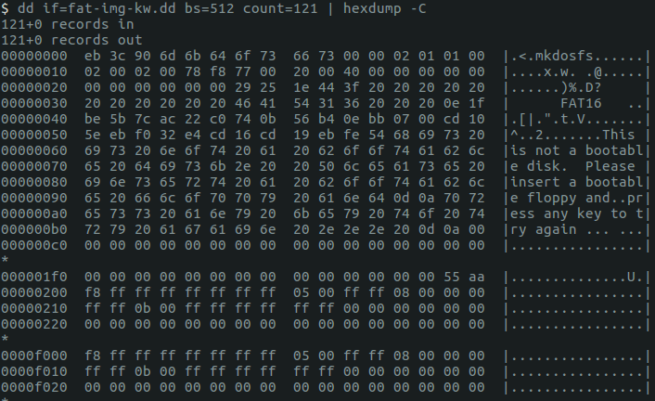
FAT16 Analysis - Practical

Slide 45
Image Details
DOS / MBR Record Sector
Code Offset: 0x3C+2 => 62
OEM-ID: mkdosfs
Sectors: 30720 => 15.7 MB
Media Descriptor: 0xF8 => Hard Disk
Serial Number => 0x3F441E25
FAT16 File system

Slide 46
FAT16 Analysis - Practical
For the given image find the following information:
The size of the reserved area
The size of FAT 1
The size of FAT 2
The size of root directory
The size of the data area
With hexdump show the header for each of the following:
The size of the reserved area
The size of FAT 1
The size of FAT 2
The size of root directory
The size of the data area
Confirm these results with the fsstat tool

Slide 47
FAT16 Analysis - Practical
From the image we can find the following information from the reserved area:
Bytes / Sector: 512
Reserved Sectors: 1
# FATs: 2
Directory Entries: 512
# Sectors / FAT: 119
# Sectors: 30,720
Bytes / Sector: 512
Reserved Sectors: 1
# FATs: 2
# Directory Entries: 512
# Sectors / FAT: 119
# Sectors: 30,720

Slide 48
Reserve Area Structure - Practical
So just from the information found in the reserved area we denote the following:
1
119
119
?
?
Sector 1 - 119
Sector 120 - 238
Sector ? - 30719
Sector 0
Sector 239 - ?

Slide 49
Root Directory Structure
Each entry of the root directory is 32 bytes in size
The root directory has a total of 512 entries, which was found in the reserved area
512 * 32 = 16,384 bytes / 512 bytes / sector = 32 sectors

Slide 50
Reserve Area Structure - Practical
Just from the information found in the reserved area and knowledge of the root directory we can specify all values for the FAT16 data structure
1
119
119
32
30,449
Sector 1 - 119
Sector 272 - 30719
Sector 120 - 238
Sector 0
Sector 239 - 271

Slide 51
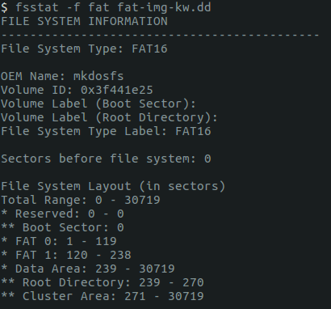
Reserve Area Structure - Practical
Results from hexdump analysis:
- Reserved Area: Sector 0
- 1st FAT Area: Sector 1 – 119
- 2nd FAT Area: Sector 120 – 238
- Root Directory: 239 – 270
- Data Area: 239 - 30719

Slide 52
How To Analyze Files
Now that we have confirmed the proper size of the FAT16 file system and the component parts, the next thing to do is to consolidate
File Allocation Table
Root Directory Entries
1
119
119
32
30,449
Sector 1 - 119
Sector 272 - 30719
Sector 120 - 238
Sector 0
Sector 239 - 271

Slide 53
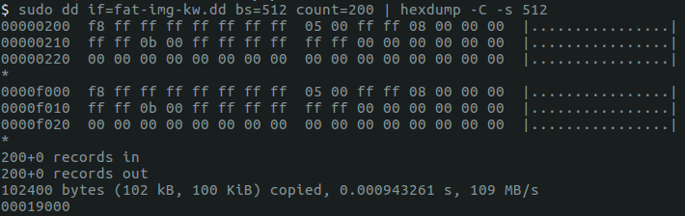
File Allocation Table
The file allocation table is located from sector 1 – 119
Sector 1 – 119
Byte 512 – 60,928
Address 0x200 – 0xEE00

Slide 54
File Allocation Table
The file allocation table specifies where in storage the contents of a file reside
In order to find the contents of a file we will follow the next sector until an end of file marker is indicated
0xFFFF
The File Allocation Table only tells one part of the story, we will also need the directory entries to know which files are associated with which sectors in the FAT
FAT
Sector | Next Sector
0x0000 | 0xFFF8
0x0001 | 0xFFFF
0x0002 | 0xFFFF
0x0003 | 0xFFFF
0x0004 | 0x0005
0x0005 | 0xFFFF
0x0006 | 0x0008
0x0007 | 0x0000
0x0008 | 0xFFFF
0x0009 | 0x000B
0x000A | 0xFFFF
0x000B | 0xFFFF
0x000C | 0xFFFF
0x000D | 0x0000
0x000E | 0x0000
0x000F | 0x0000

Slide 55
Root Directory Structure
The root directory structure from sector 239 – 271
Sector 239 – 271
Byte 122,368 – 138,752
Address 0x1DE00 – 0x21E00
Using this information, we can craft a hexdump that will only display the specific areas of disk we want to analyze
sectors
bytes
sudo dd if=fat-img-kw.dd bs=512 count=271 | hexdump –C –s 122368 –n 16384
In English: Take the binary output of the raw dd image in blocks of 512 through sector 271 and display both the hexadecimal and ASCII starting at byte 122,368 for 16,384 bytes

Slide 56
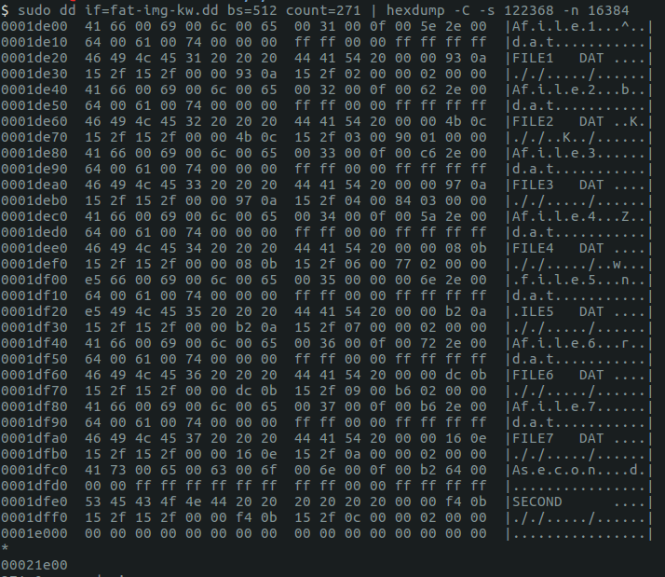
Root Directory Structure

Slide 57
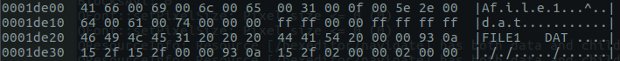
Directory Entries
Status: 0x41 – Normal File
Filename: “FILE1 “
Extension: “DAT”
Attribute: 0x20 → Archive Flag
Reserved: 0x0000930A152F152F0000
Time: 0x930A → 1:20:38
Date: 0x152F → 8/21/2003
Cluster: 0x0002 → Cluster 2
File Size: 0x00000200 → 512 bytes

Slide 58
Status Bytes
In addition to normal files, there are additional file status codes:
0x00 – Filename Never Used
0xe5 – Filename Used, But Deleted
0x2e – Directory
0x41 – Normal File

Slide 59
Attribute
In addition to normal files, there are additional file status codes:
0x01 – Read Only
0x02 – Hidden
0x04 – System
0x08 – Volume Label
0x10 – Directory
0x20 – Archive
0x0F – Long File Name

Slide 60
Time Calculation
0x0A93
0x00
0000101010010011
Hours
Minutes
Seconds
msec
1
20
38
0

Slide 61
Date Calculation
0x2F15
0010111100010101
Year
Month
Day
2003
8
21

Slide 62
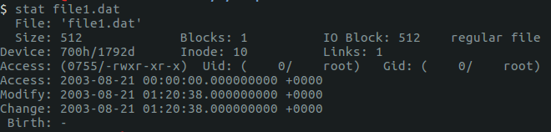
Confirm Time & Date Calculations
0x0A93
0x2F15
0000101010010011
0010111100011001
Hours
Minutes
Seconds
Year
Month
Day
1
20
38
2003
8
21

Slide 63
DES - FAT Example
File Allocation Table
512 bytes / sector
4 sectors / cluster
2048 bytes / cluster
Cluster | Next Cluster
0 | 1
1 | 2
Directory Entry Structure
1000 | 1001
1002 | 1003
1003 | 1004
1004 | FFFF
1005 | 1006
1006 | 1007
1007 | 1008
1008 | 1009
1009 | FFFF
1010 | 1011
1011 | 1012
Filename | Cluster | File Size
Budget.txt | 1000 | 7980 bytes
Resume.docx | 1005 | 10120 bytes
Algorithm.py | 1010 | 60295 bytes
The directory entry structure specifies the starting cluster and the file size
The FAT points to follow-on cluster or the end of the file (i.e. 0xFFFF)
1037 | 1037
1038 | 1039
1039 | FFFF

Slide 64
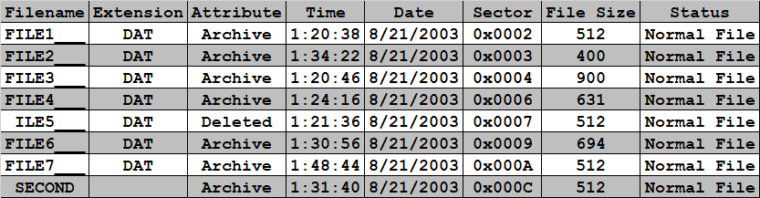
All Directory Entries
Using the same method, the following table gives us details of every directory entry

Slide 65

List Directory Entries
FAT
Now we can combine the FAT and directory entries to find the contents of each file
Data Area Sector | Next Sector
0x0000 | 0xFFF8
0x0001 | 0xFFFF
0x0002 | 0xFFFF
0x0003 | 0xFFFF
0x0004 | 0x0005
0x0005 | 0xFFFF
0x0006 | 0x0008
0x0007 | 0x0000
0x0008 | 0xFFFF
0x0009 | 0x000B
0x000A | 0xFFFF
0x000B | 0xFFFF
0x000C | 0xFFFF
0x000D | 0x0000
0x000E | 0x0000
0x000F | 0x0000
+2

Slide 66
Where does file data start?
The start of file
contents is at
sector 273
1 + 119 + 119 + 32 + 2 = 273
1
119
119
32
30,449
Sector 1 - 119
Sector 272 - 30719
Sector 120 - 238
Sector 0
Sector 239 - 271

Slide 67
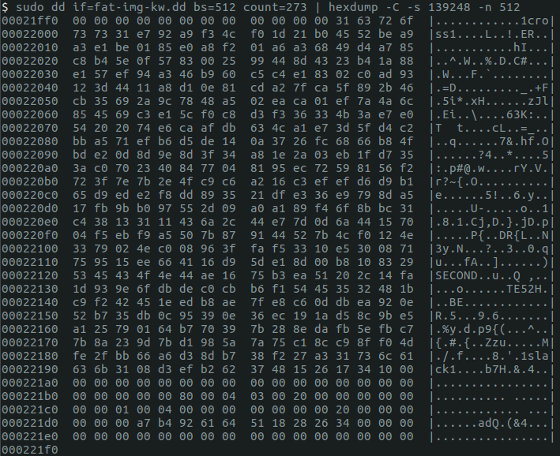
File Contents – Existing File
File1.dat

Slide 68
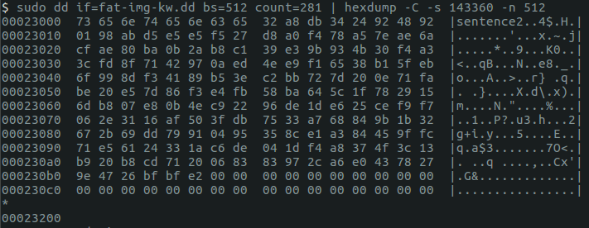
File Contents – Deleted File
ile5.dat

Slide 69
Introduction to Sleuth Kit

Slide 70
Sleuth Kit History
Coroner's Toolkit (TCT) – 2000
First free and open source digital forensic toolkit
Limitations
Platform and OS dependent
File system tools not well developed for file and directory analysis
Did not support FAT and NTFS
Sleuth Kit built off of TCT and expanded tool capability - 2001
Platform and OS independent
Covers all levels of file system abstraction
Supports FAT and NTFS
Sleuth Kit is composed of 20 CLI tools and also has a front-end called Autopsy

Slide 71
Sleuth Kit Command Prefix
Sleuth Kit commands are composed of two parts:
Sleuth kit commands have prefixes based on logical layers specified earlier:
Disk
Partition / Volume (mm-)
File System (fs-)
Data Units (blk-)
Metadata (i-)
File Name (f-)
Two additional prefixes are Sleuth kit commands have prefixes and suffixes and are based, mostly, on the logical layers specified earlier:
Hash Information (h-)
File system journals (j-)
Image Tools (img-)
Prefix
Suffix
Group
Function
Digital Forensics with Open Source Tools, Chapter 3

Slide 72
Sleuth Kit Commands Relative to
File System Abstraction
DISK
PARTITION
FILE SYSTEM
DATA UNIT
METADATA
FILE NAME
mm-
fs-
blk-
i-
f-

Slide 73
Sleuth Kit Suffix
Sleuth kit commands also uses suffixes based on function:
List (-ls)
Statistics (-stat)
Dump (-cat)
Search (-find)

Slide 74
Sleuth Kit Commands Examples
blkcat - Display the contents of file system data unit in a disk image
blkls - List or output file system data units
blkstat - Display details of a file system data unit
fcat - Output the contents of a file based on its name
ffind - Finds the name of the file or directory using a given inode
fls - List file and directory names in a disk image
fsstat - Display general details of a file system
hfind - Lookup a hash value in a hash database
ifind - Find meta-data structure
ils - List inode information
img_cat - Output contents of an image file
img_stat - Display details of an image file
istat - Display details of a meta-data structure
jcat - Show the contents of a block in the file system journal
jls - List the contents of a file system journal
jpeg_extract - jpeg extractor
mactime - Create an ASCII time line of file activity
mmcat - Output the contents of a partition to stdout
mmls - Display the partition table
mmstat - Display details of the partition table
sigfind - Find a binary signature in a file
sorter - Sort files in an image into categories based on file type
srch_strings - Display printable strings in files
tsk_gettimes - Collect MAC times from a disk image into a body file
tsk_loaddb - populate a SQLite database with metadata from a disk image
tsk_recover - Export files from an image into a local directory
http://wiki.sleuthkit.org/index.php?title=The_Sleuth_Kit_commands

Slide 75
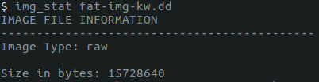
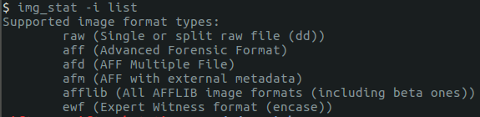
Image Information – img_stat
img_stat displays information about the image
TSK supports numerous image types
img_stat –i list

Slide 76
Partition Focused Sleuth Kit Commands
DISK
PARTITION
FILE SYSTEM
DATA UNIT
METADATA
FILE NAME
mm-

Slide 77
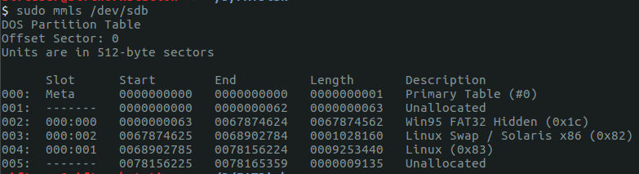

Partition Information – mmls
mmls - Displays both allocated and unallocated space
mmstat – Volume Type
mmcat – For partition imaging

Slide 78
File System Focused Sleuth Kit Commands
DISK
PARTITION
FILE SYSTEM
DATA UNIT
METADATA
FILE NAME
fs-

Slide 79
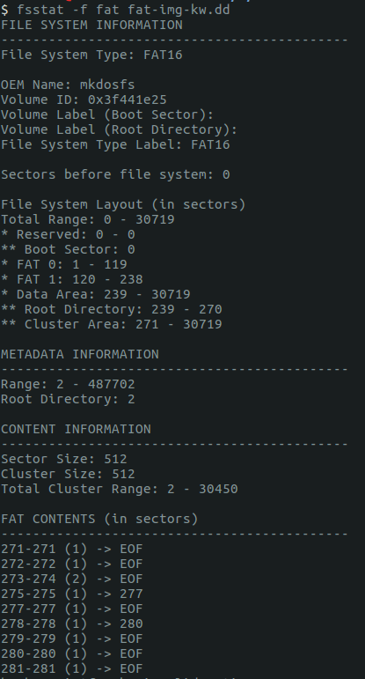
FAT16 File System Statistics - fsstat

Slide 80
FAT16 File Sectors - fsstat
fsstat also provides information about signatures related to file footers
EOF (0xFFFF)
Next Sector (0x????)

Slide 81
Data Unit Focused Sleuth Kit Commands
DISK
PARTITION
FILE SYSTEM
DATA UNIT
METADATA
FILE NAME
blk-

Slide 82
Data Unit Commands
The data unit level tools in Sleuth Kit help extract unallocated space from an image
There are four Slueth Kit tools at the data unit level that help with this process:
blkcat
Extracts the contents of a given data unit
blkls
Lists data unit details
Extracts unallocated file system space
blkstat
Displays data unit statistics
blkcalc
Identifies where data resides in unallocated space

Slide 83
Metadata Focused Sleuth Kit Commands
DISK
PARTITION
FILE SYSTEM
DATA UNIT
METADATA
FILE NAME
i-

Slide 84
Metadata Commands
The metadata level tools in Sleuth Kit help extract unallocated space from an image
There are four Slueth Kit tools at the data unit level that help with this process:
ifind
Find meta-data structure
ils
List inode information

Slide 85
Filename Focused Sleuth Kit Commands
DISK
PARTITION
FILE SYSTEM
DATA UNIT
METADATA
FILE NAME
f-

Slide 86
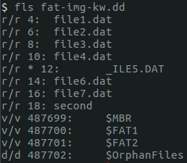
File Layer List - fls
Sleuth Kit can specify all existing and deleted files along with data structure of the file system
-: Unknown type
r: Regular file
d: Directory
c: Character device
b: Block device
l: Symbolic link
p: Named FIFO
s: Shadow
h: Socket
w: Whiteout
v: TSK Virtual file / directory
*: Unallocated Space
Root
Directory
Entries

Slide 87
Creating Test Disks

Slide 88
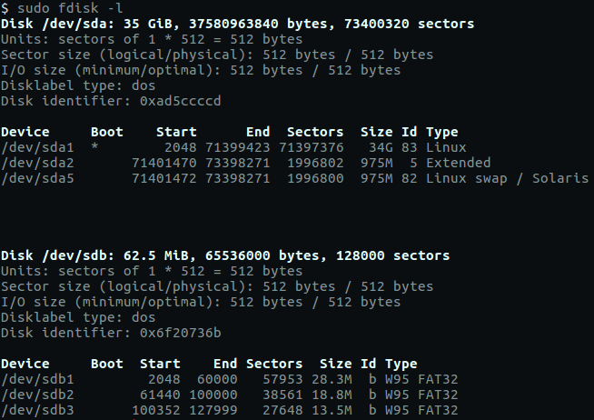
Identify Current Disk Parameters
Use fdisk to identify file systems and partitions currently on the disk you are going to create

Slide 89
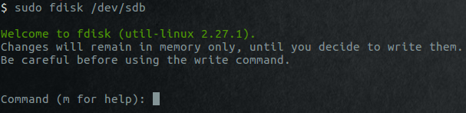
fdisk
Select the correct disk

Slide 90
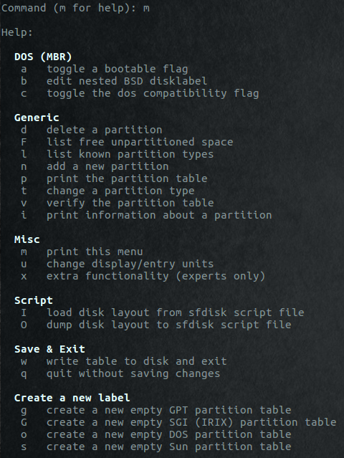
fdisk Options

Slide 91
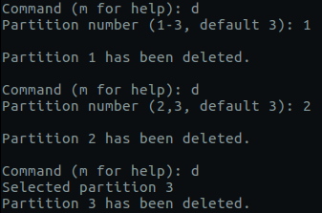
Delete Existing Partitions
Delete all existing partitions on the disk you are going to re-partition

Slide 92
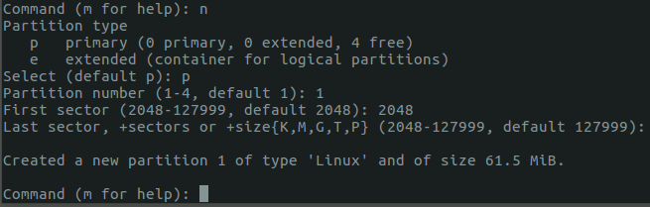
Create New Partition
Create a new partition
Default “Linux”

Slide 93
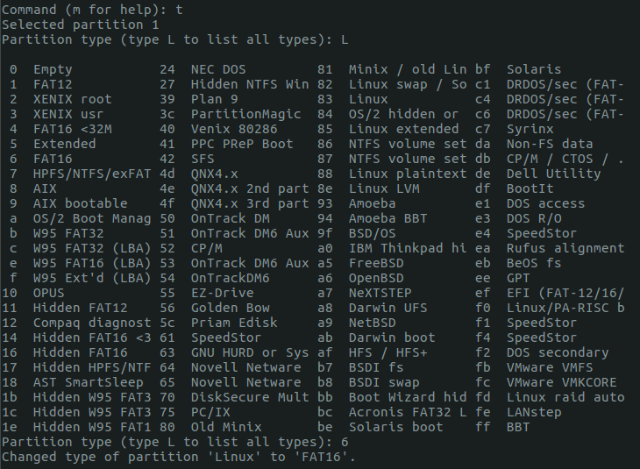
Modify Partition
Change to FAT16 partition

Slide 94
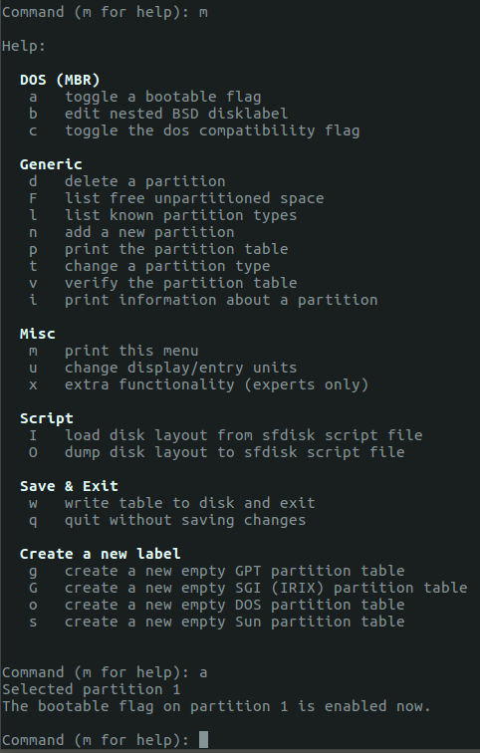
Change Bootable Parameter
Change to bootable disk

Slide 95
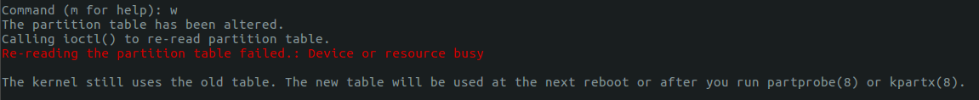
Write Changes
Write changes to disk
sudo fdisk -l

Slide 96
Format the Partition
After creating the area for the partition, we will next use mkfs which formats the partition
sudo mkfs.fat -F 16 /dev/sdc1
Make a FAT File System
16-bit FAT entries

Slide 97
Homework #3
Using the fdisk utility:
Create a thumb drive with 2 equally sized FAT16 partitions
Set the 2nd partition to bootable
Complete the following tasks:
Specify how many sectors are on each partition
2) Using hexdump print out the boot sector for the 2nd partition
3) Specify how many sectors are in each of the following:
Reserved Area
1st FAT Area
2nd FAT Area
Root Directory
Data Area
Create a word document that answers each of the questions and add any necessary screenshots to back up your answers
Homework #3 is due 1 February 11:59 PM

Slide 98
References
File System Forensic Analysis, Carrier, 2005
FAT Volume Serial Numbers
https://www.digital-detective.net/documents/Volume%20Serial%20Numbers.pdf
File Allocation Tables
https://slideplayer.com/slide/9087283
https://www.slideshare.net/shashikantpabari/file-system-and-file-allocation-tablesystem
https://doc.micrium.com/display/fsdoc/Organization+of+a+FAT+Volume

